Slide 1

F1 Grand Prix Race Win Predictor – Sprint 2

Slide 2




Reintroduction to the Problem Space
Predicting F1 winner: complex problem
Binary classification problem : Win (1) or Not Win (0)
Models for Sprint 2
- Logistic Regression
- Decision Tree
- Random Forest

Slide 3




Data Overview and Changes
Dataset V2: focuses on pre-race factors.
Excludes in-race statistics: e.g. pit stops.
Features engineered: e.g. cumulative season points
Original data trimmed for predictive relevance.
Notes:
During Sprint 2, we refined our dataset, focusing on features that could predict race outcomes before they happen. We removed in-race data like pit stop counts, which aren't known beforehand and therefore don't aid in pre-race predictions.
We addressed missing values and eliminated duplicates, which not only cleans the data but also helps to prevent model biases that could distort the predictions.
Feature engineering was a major step in this phase. We created new variables to encapsulate the cumulative performance across the season, both for constructors and drivers, which are significant predictors of race-winning likelihood.

Slide 4
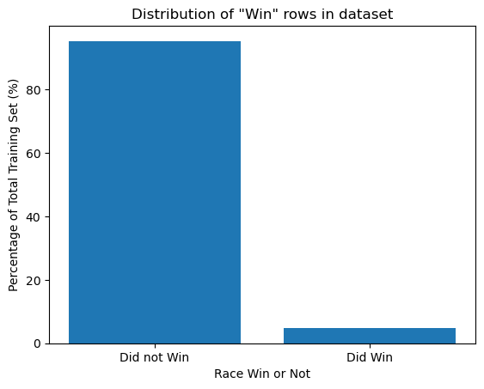
Dataset is heavily Class Imbalanced…

Slide 5
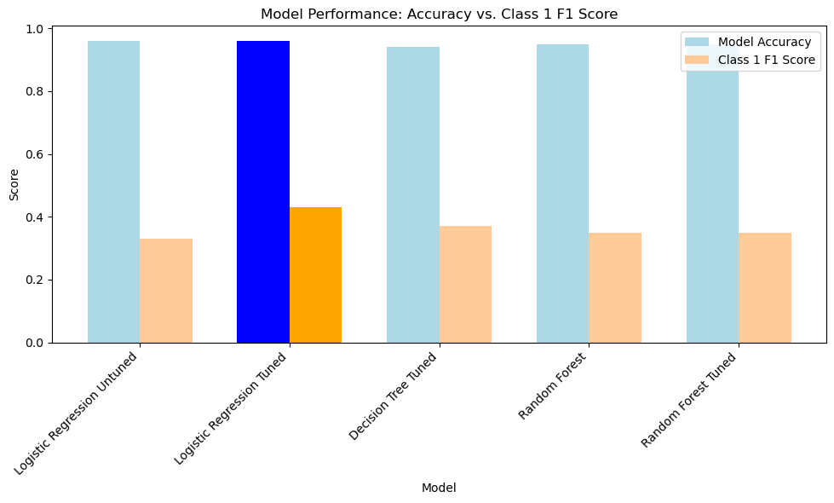

Results of our first models
Model Accuracy : 95%
Class 1 F1 : 43%
Recall : 32%|Precision : 64%
Benchmark : Predict each row will not win and you will be 95% accurate.
Notes:
- Showcases how the 'Logistic Regression Tuned' model outperforms others in both model accuracy and Class 1 F1 Score It's visually distinct with bright blue and orange bars, emphasizing its superior predictive power for F1 race winners. Clas
Important to note that a naïve model would be to always guess “non-win” and you will be right 95% of the time, but you wouldn’t be able to predict a winner
Logistic Regression Model had 95% accuracy, but (recall of 32% and Precision of 64%) for predicting winners, so at least we are picking winners.

Slide 6
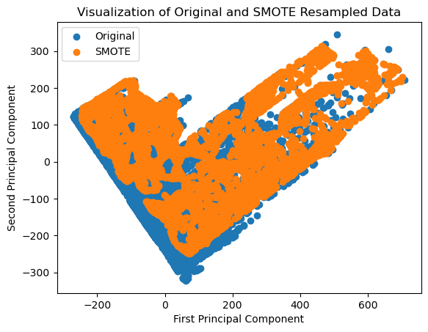
Data Pit Stop: SMOTE's Role in Tuning Predictive Models
Notes:
- The slide displays a scatter plot of the original dataset against the SMOTE resampled data, visualized through principal component analysis (PCA). PCA reduces the data to two dimensions, labeled here as the 'First Principal Component' and 'Second Principal Component,' which capture the most variance within the dataset, allowing us to see patterns and clusters more clearly.
- SMOTE, or Synthetic Minority Over-sampling Technique, is illustrated by the orange dots, showing how it populates the data space with synthetic points to balance the classes. This helps address the problem of class imbalance where one outcome is much rarer than the other, which is common in datasets of rare events like F1 race wins.
- This balance achieved by SMOTE is crucial for building robust models because it helps to prevent the model from being biased towards the majority class. By providing a more equal representation of both outcomes in the data, our predictive models can learn to better generalize and thus more accurately predict F1 race winners.

Slide 7
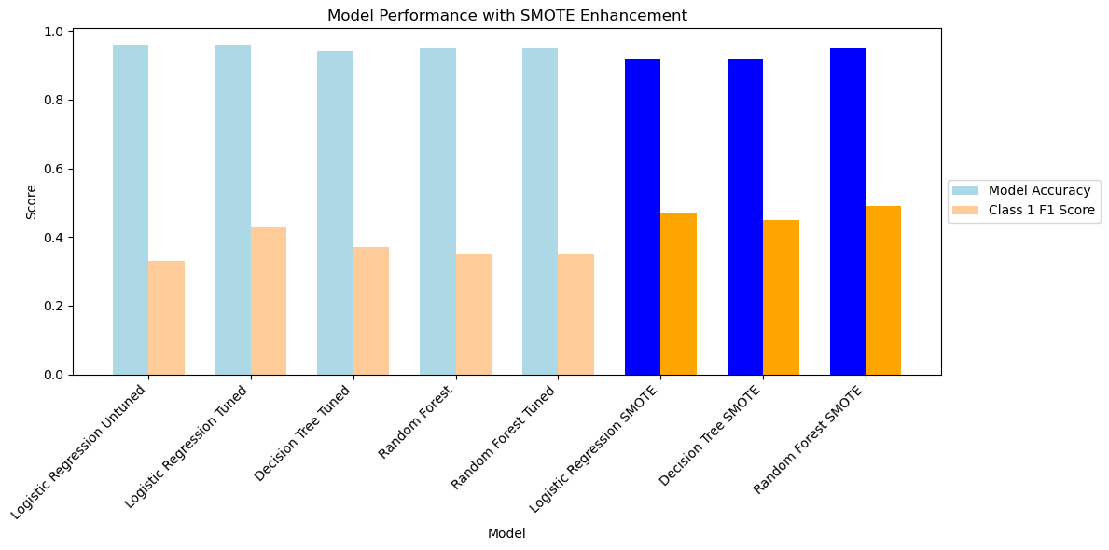
SMOTE – Produced the best models so far…
Benchmark : Predict each row will not win and you will be 95% accurate.
Model Accuracy : 95%
Class 1 F1 : 49%
Recall : 47% |Precision : 51%
Notes:
The table compares the performance of different predictive models based on their accuracy and precision in classifying F1 race outcomes. The Random Forest SMOTE model stands out as the best so far, with a balance between model accuracy (95%) and class 1 F1 score (0.49), indicating a strong performance in both classes of predictions.
The benchmark mentioned suggests that simply predicting that a race will not be won (likely referring to a specific driver or team) would result in a 95% accuracy rate. This highlights the imbalance in the dataset, where a naïve model with a one-sided prediction could appear deceptively effective. The Random Forest SMOTE model’s accuracy aligns with this benchmark but also improves precision and recall for the minority class, which is more challenging in imbalanced datasets.
The SMOTE technique, which stands for Synthetic Minority Over-sampling Technique, has been applied to Logistic Regression and Decision Tree models as well, but the Random Forest with SMOTE yields better performance metrics, specifically in Class 1 precision and F1 score, demonstrating its effectiveness in handling class imbalance for this specific prediction task.

Slide 8



Next Steps for Sprint 3…
Further Feature Engineering: enhance predictive power
Test Other Methods To Reduce Class Imbalance
Further Modelling Techniques: e.g. Neural Networks
Profit and Loss Analysis: Make money?
Model Interpretation : What makes a winner?
Notes:
During Sprint 2, we refined our dataset, focusing on features that could predict race outcomes before they happen. We removed in-race data like pit stop counts, which aren't known beforehand and therefore don't aid in pre-race predictions.
We addressed missing values and eliminated duplicates, which not only cleans the data but also helps to prevent model biases that could distort the predictions.
Feature engineering was a major step in this phase. We created new variables to encapsulate the cumulative performance across the season, both for constructors and drivers, which are significant predictors of race-winning likelihood.

Slide 9

Thanks for your time

